Slide 1

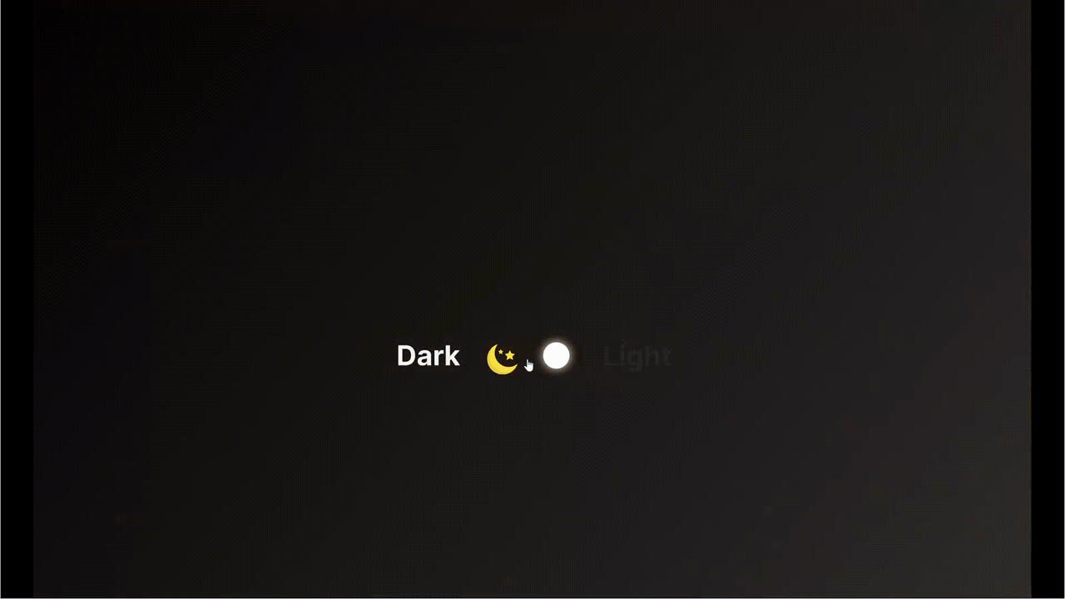
Toggle Button (Day/Night)
Link: https://www.figma.com/proto/vo6OEtcOT1bCFBM5qNVDmR/Figma-Switch-Day%2FNight?node-id=0-1&t=JXrTZKdkjdMX7Epz-1

Slide 2
